Slide 1

Benefits and Challenges of Mixing Sports into a Physics Course
M. A. Yousuf (mali@jhu.edu)
and
Vicky Schneider (vschneider@jhu.edu)
62nd Annual NAGC Convention, November 12-15, 2015
Phoenix, Arizona
Network Strand: Curriculum Studies

Slide 2
Contents
Introduction to Physics of Sports
Course Description (CTY Website)
Mathematics background required
Course design
Demos using Ping-Pong balls
Comments on NGSS and this course
Open Access teaching material and references
Summary

Slide 3
Objectives
  about the course and what it tries to achieve
  some sports ideas / tabletop demos which are good match for core physics topics
  how to tie your course content to the Next Generation Science Standards (NGSS).
  how ‘Physics of Sports’ encourage the use of diverse teaching strategies and methodologies, including the role and value sports coaches in such courses

Slide 4
History
What is CTY? And PHSP?
A total of 12 groups (3 years) offered to date
5 hours class + 2 hour tutorial sessions per day, 5 days a week
Grades 7-10 students with minimal math background

Slide 5
Details

Slide 6
Course Description (from CTY website)
How does a pitcher get a baseball to curve in flight? Why does an ice skater spin faster when she pulls her arms in? How can Tony Hawk land a “900,” a trick involving the completion of two-and-a-half aerial revolutions on a skateboard? Physics holds the key to answering these and other fascinating sports questions.
In this introductory physics course, students use sports to explore mechanics: kinematics, dynamics, momentum, energy, and power. For example, students may experiment with billiard balls as they investigate collisions and conservation of momentum. They may study centripetal forces to determine how fast a race car driver can take a turn. Or they may use kinematics and projectile motion to discover the best angle to shoot a basketball. For each physics concept studied, students explore real-world applications in sports.
Through lectures, hands-on activities and labs, simulations, mathematical problem sets, and research projects, students develop a strong understanding of classical physics and learn the principles that give star athletes an edge over their competitors.
Download sample syllabus from:
http://cty.jhu.edu/summer/grades7-12/academic/catalog/science.html#phsp

Slide 7
Course Design: Sports Motivated Teaching of Physics
Aerodynamics
Rotating Machines
Sailing
Ballistics
High speed autos
Physics
Applications
Physics
Theory
(2D Kinematics, Forces, Momentum, Energy, etc)
Physics
Theory
Who are the students?
Sports
Physics of
Sports
Motivation
Phase
Learning
Phase
Chaos
Order

Slide 8
Mathematics background required
At the minimum, students should know:
  Introduction to integers and algebraic expressions
  Fraction notation: Multiplication, Division, Addition and Subtraction
  Decimal notation
  Introduction to graphing and statistics
  Ratio and proportion
  Percent notation
  Geometry and measurement
  Polynomials

Slide 9
Table-top Demos

Slide 10
Material Required for these demos
Ping-Pong balls
Access to a ping-pong table will be helpful but not required
Construction tape to draw lines on the desk
Ruler to measure distances
Plasticine or something similar to stick to the ball

Slide 11

A few demos using Ping-Pong balls
From a teacher’s perspective, using sports to explain physics concepts might be fun and engaging for the students; however, how exactly does one determine which sports are a good match for these concepts?
Let discuss a few examples …

Slide 12
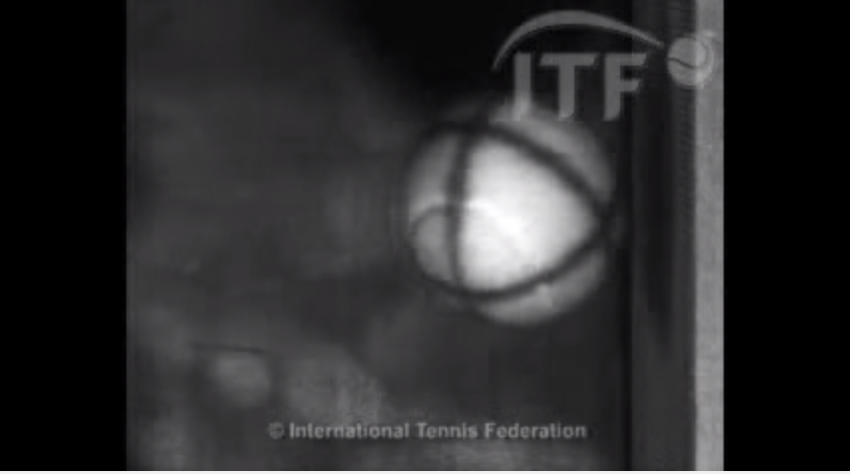
A few points to review before we start:
Mechanisms through which a bouncing ball can lose energy:
  Friction with air molecules
  Sound
  Deformation of the ball
  Heat energy in the bounce
https://youtu.be/aGsntCznhcY?t=6s

Slide 13
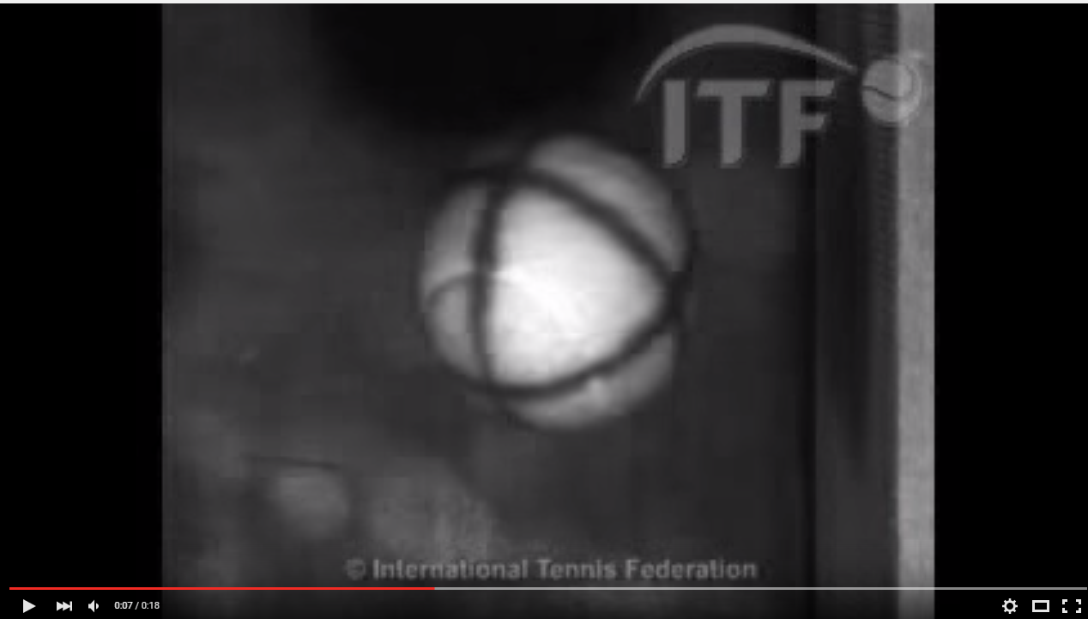
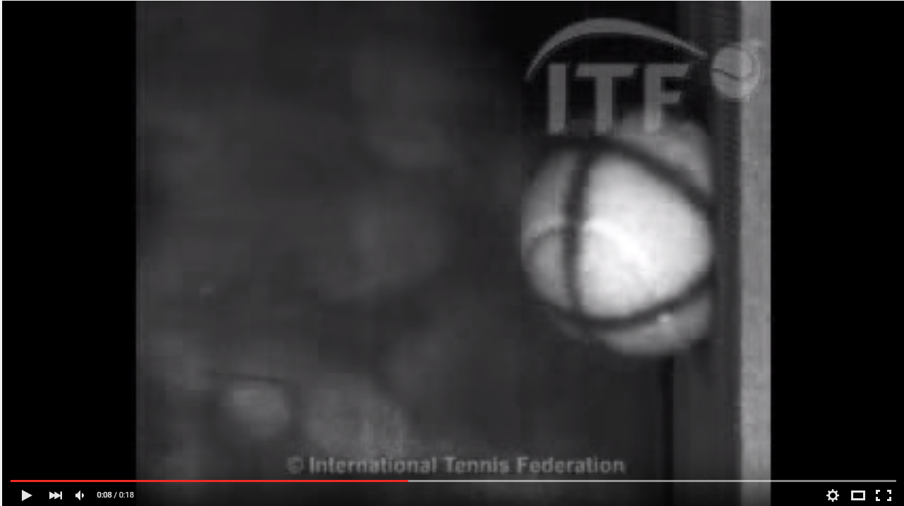
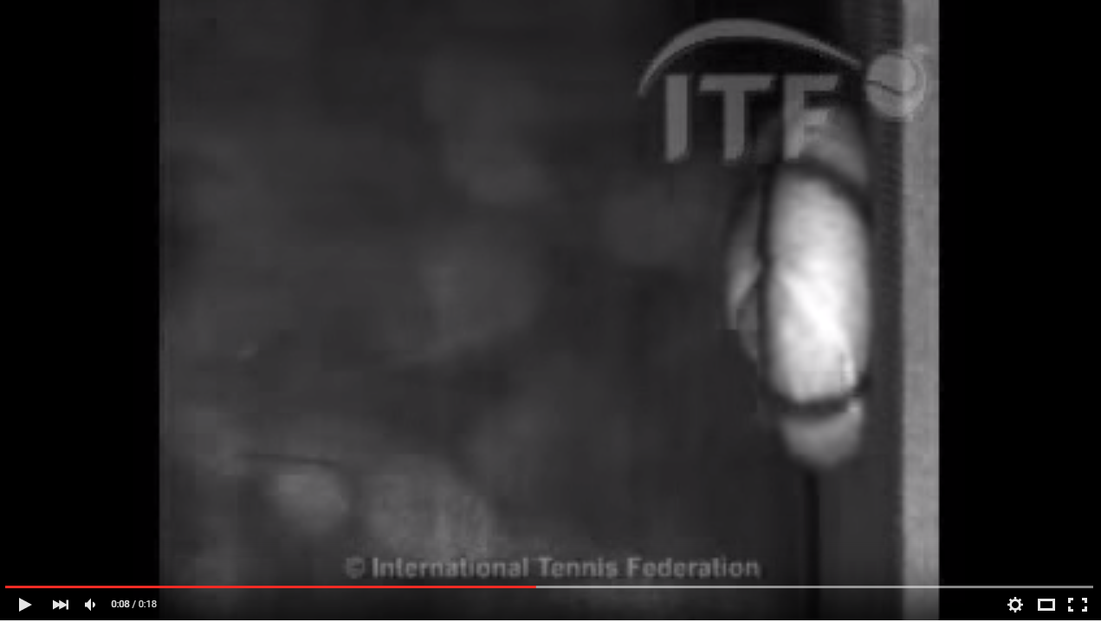
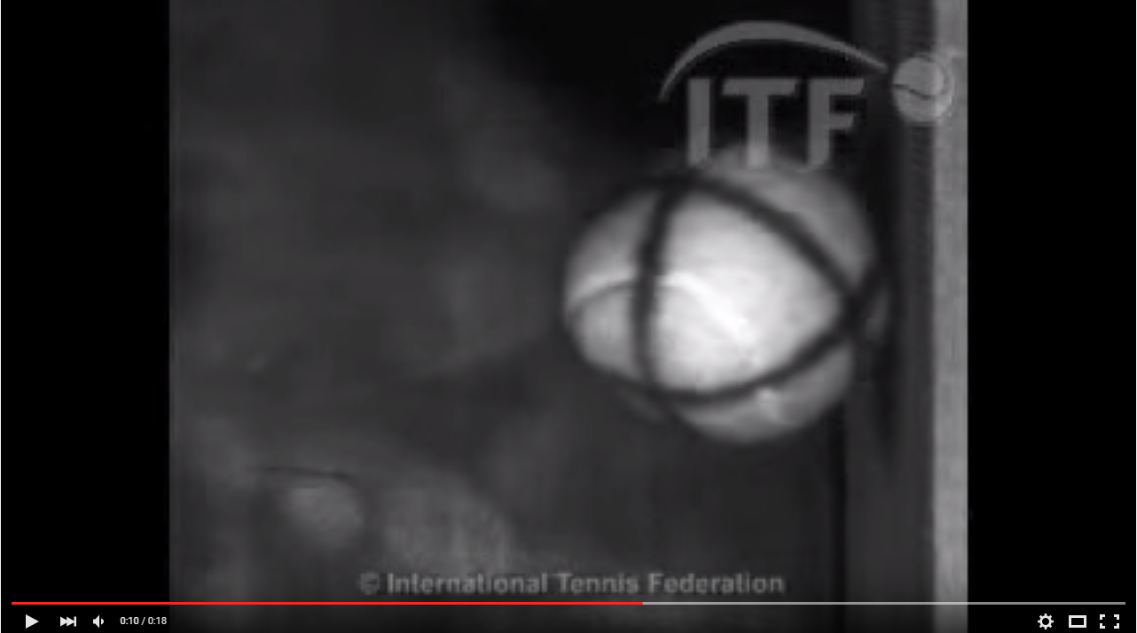

Slide 14
Demo 1
Pushing a ball downwards makes it move forward but then it comes back. Which forces were acting on it? Which velocity is greater – linear or rotational?
What will happen to a rotating ball on the table if there is no friction on the table?
See Mr. Beans doing something similar https://youtu.be/QE6PvNohffc?t=2m25s

Slide 15
A few questions to keep in mind:
A ball rotates and stops after some time – no kinetic energy. But energy is always conserved so what happened to the kinetic energy?
A rotating ball on the table stops rotating after some time. It loses all its linear momentum. But momentum is always conserved. So what happened to it?
A rotating ball on the table stops rotating after some time. It loses all its angular momentum. But momentum is always conserved. So what happened to it?

Slide 16
Demo 2
What happens to balls moving in air? Which forces act on them?
Try a strip of paper first and see the next slide

Slide 17
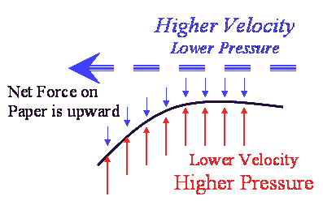
http://www.csun.edu/scied/4-discrpeant-event/Bernoulli_effect/bernoulli.gif

Slide 18
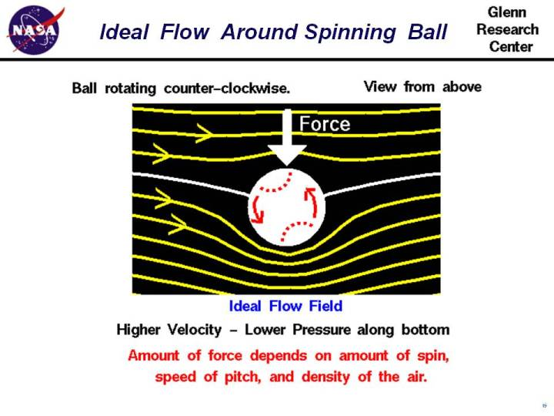
Arrows are in opposite directions
Arrows add on this side
== > higher velocity
== > lower pressure
https://www.grc.nasa.gov/www/k-12/airplane/bball.html

Slide 19
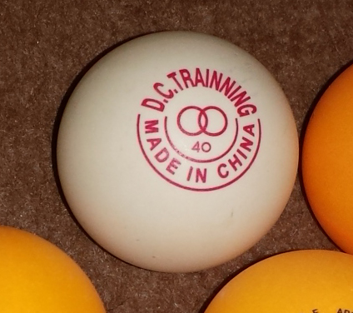
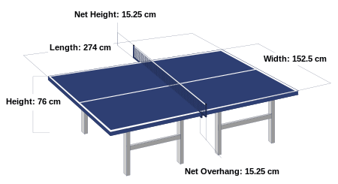
Demo 3 (With multiple topics)
Data: Table Tennis and Ping-Pong Ball
First played in 1880s (England)
Ping-Pong Ball (Olympics)
  Diameter = 4 cm = 0.04 m
  Mass = 2.7 g = 0.0027 Kg
Table dimensions
  2.74 m (length)
  1.525 m (breadth)
  0.76 cm (height)
Speed of the ball, v = 1.0 m/s (rotational), v= 12 m/s (linear, at tracking limit)*
https://en.wikipedia.org/wiki/Table_tennis
*v values taken from http://www.uphysicsc.com/2012-GM-B-414.PDF

Slide 20
More on Measurements
Measurements of ball, racket and table + conversion of units
What is the volume of the ball?
What is the surface area?

Slide 21
Topic 2: Materials
Materials used for ball, table, net, etc [Research Project]

Slide 22
Topic 3: Quality assurance
  The standard table yields a uniform bounce of about 23 cm when a standard ball is dropped onto it from a height of 30 cm, or about 77%
  Check your table(s) using different balls [Lab Project]
  The rules say that the ball shall bounce up 24–26 cm when dropped from a height of 30.5 cm onto a standard steel block. Check it [Lab Project]
    Note: the above is a measure of the ‘bounciness’ of the ball, measured by the coefficient of restitution

Slide 23
Topic 3: Quality assurance
Demo and Discussion during conference
Testing the table: The standard table yields a uniform bounce of about 23 cm when a standard ball is dropped onto it from a height of 30 cm, or about 77%
Introduce concepts of Speed, Velocity and Acceleration
Estimate the time it takes to fall, from rest, to the table
Which forces are acting on the ball?

Slide 24
Topic 4: Let’s expand upon Energy
Demo and Discussion during conference
How much energy is lost in this collision?
Energy _{initial} = m g height _{initial}
Energy _{final} = m g height _{final}
Difference in energies = m g (h₂-h₁) = m g (difference in heights)
= 0.0027Kg x 9.8 m/s² x 0.07m = 0.0018 J
What happened to the energy after 3-5 collisions?

Slide 25
Topic 5: Momentum
Demo and Discussion during conference
Linear momentum of the ball during a play
Linear momentum of the ball on this table:
Where has it gone? (momentum is supposed to be conserved)

Slide 26

Look at the figure below:
Demo and Discussion during conference
https://malagabay.wordpress.com/2015/02/14/brownian-billiard-balls/

Slide 27
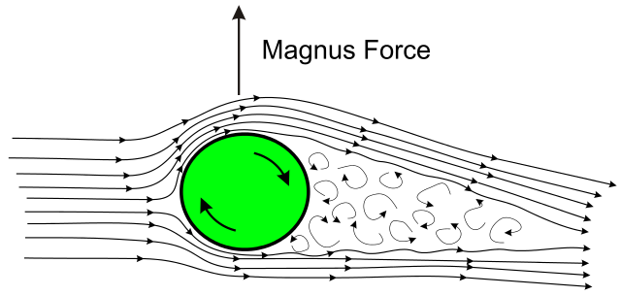
We have discussed this earlier: Magnus Effect
Demo and Discussion during conference
The Magnus effect, depicted with a backspinning cylinder or ball in an airstream. The arrow represents the resulting lifting force. The curly flow lines represent a turbulent wake. The airflow has been deflected in the direction of spin.
"Sketch of Magnus effect with streamlines and turbulent wake" by Rdurkacz - using inkscape, inspired by original versio of wikipedia diagram. Licensed under CC BY-SA 3.0 via Commons - https://commons.wikimedia.org/wiki/File:Sketch_of_Magnus_effect_with_streamlines_and_turbulent_wake.svg#/media/File:Sketch_of_Magnus_effect_with_streamlines_and_turbulent_wake.svg
https://en.wikipedia.org/wiki/Table_tennis

Slide 28
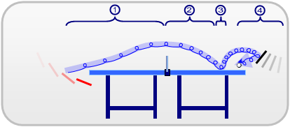
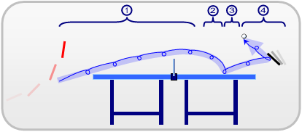
Effects of Spin
Demo and Discussion during conference
Research Project: Explore spin types and their physics
The topspin stroke has a smaller influence on the first part of the ball-curve
Backspin is where the bottom half of the ball is rotating away from the player, and is imparted by striking the base of the ball with a downward movement
4 phases in a backspin curve
4 phases in a topspin curve
https://en.wikipedia.org/wiki/Table_tennis

Slide 29
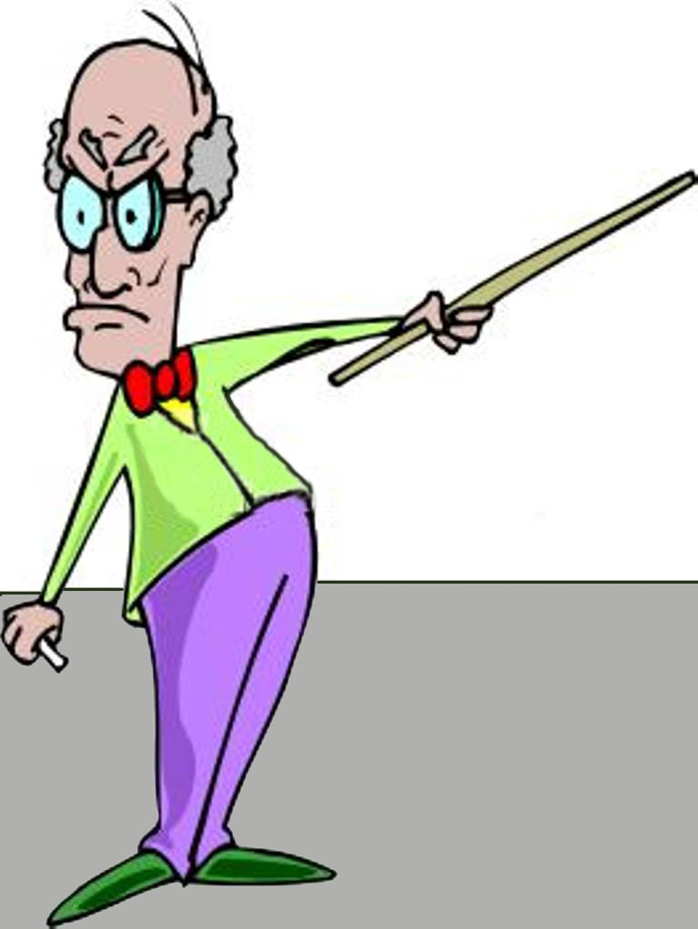
And then came the standards and assessment methods …

Slide 30
Standards and Expectations
You will find more detailed discussion in the accompanying presentation.
Here we only review the most relevant points from NGSS and how they relate to this course.
The next slide shows the relationships between various standards and benchmarks:

Slide 31
The Partnership for 21st Century Skills (P21)
Work in progress
[Ali]
Next Generation Science Standards
A Framework for K-12 Science Education by NRC
Disciplinary core ideas (content),
Scientific and engineering practices, and
Cross-cutting concepts
Benchmarks for Science Literacy - Project 2061
Mathematics Common Core State Standards
English Language Arts Common Core State Standards

Slide 32
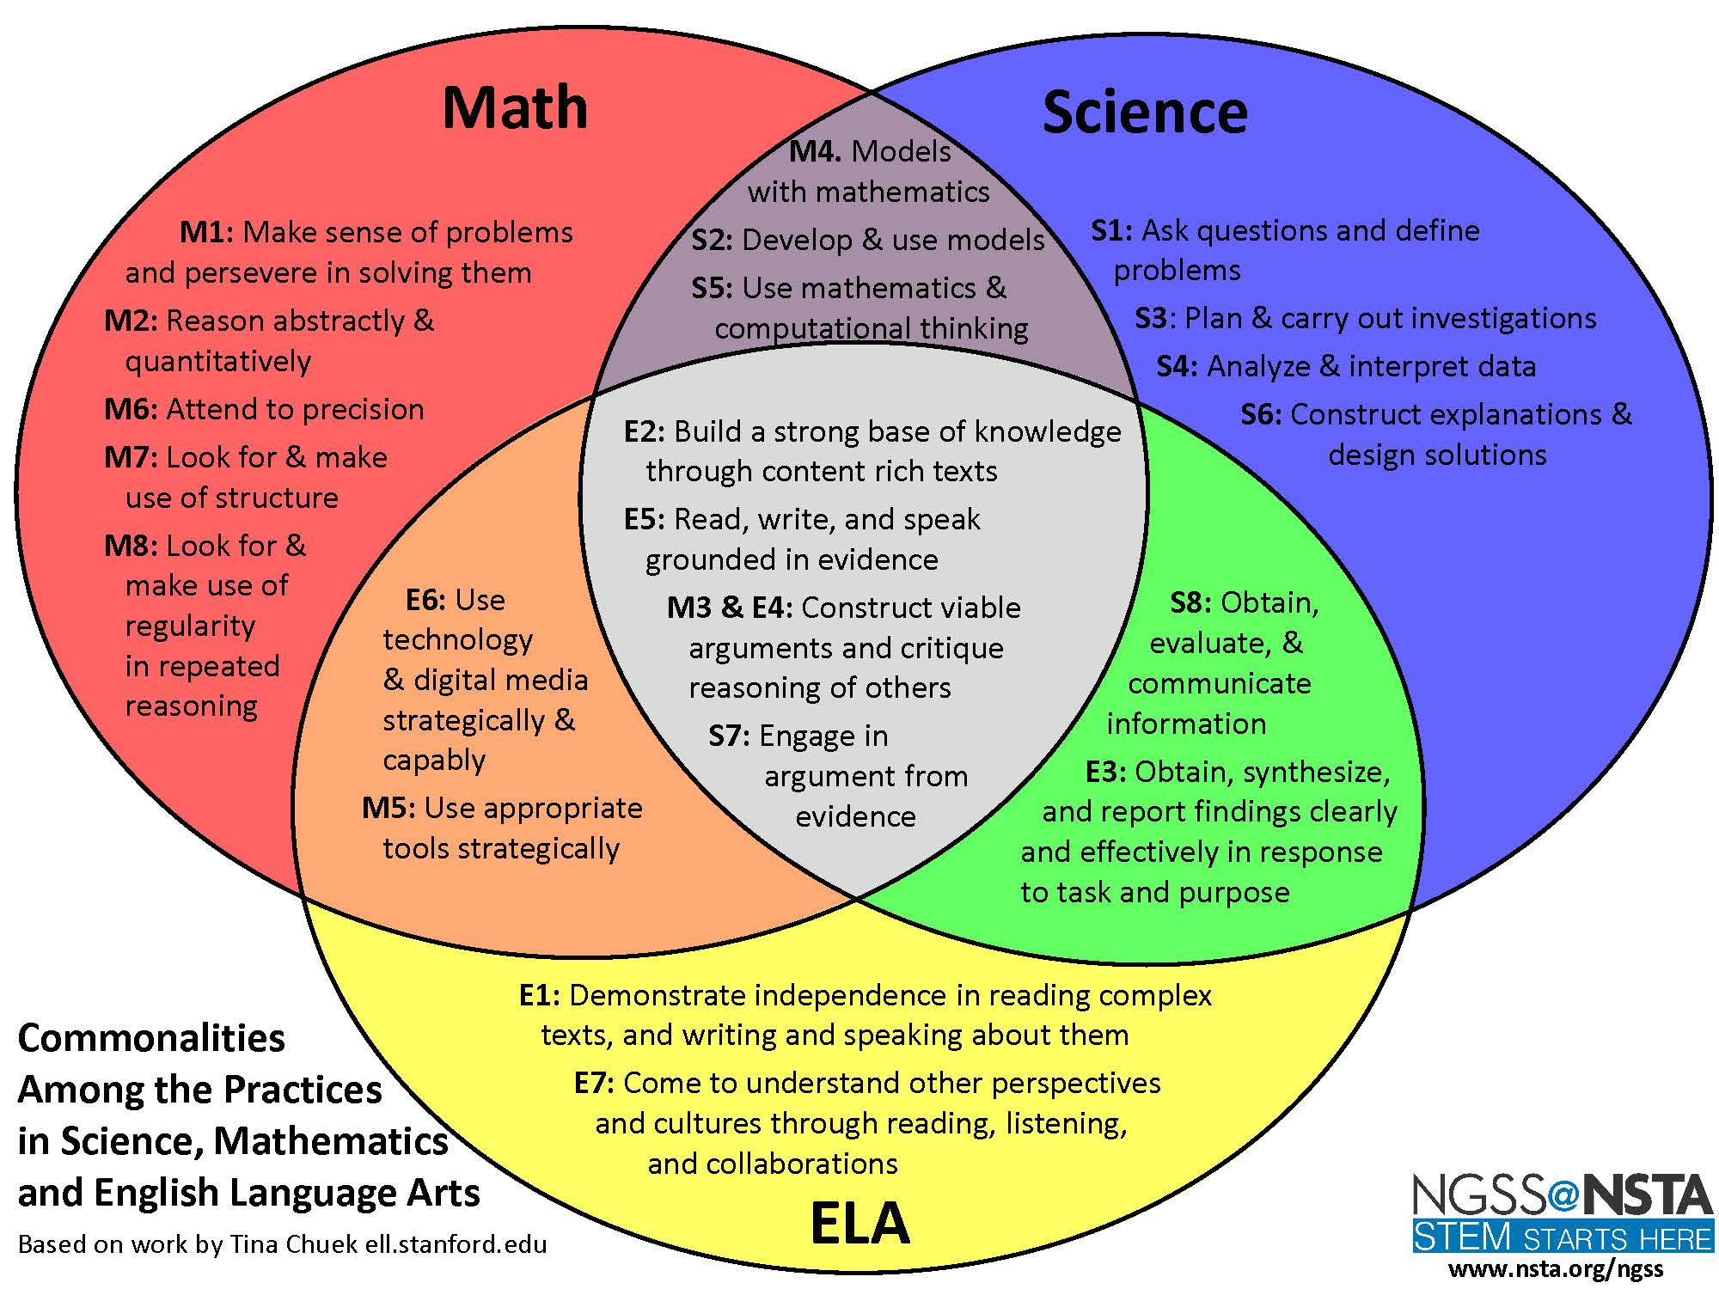
Commonalities Among the Practices in Science and Engineering in the NGSS and Mathematics in the CCSS
Ref: http://teachingcommons.cdl.edu/ngss/science_math/images/PracticesVennDiagram_Page_1_000.jpg

Slide 33
The Physical Sciences (PS)
PS2: Motion and Stability: Forces and Interactions
A. Forces and Motion
B. Types of Interactions
PS3: Energy
A. Definitions of Energy
Domain
Disciplinary Core Idea
Component Idea
B. Conservation of Energy and Energy Transfer
NGSS Framework – Some Relevant Ideas for Physics of Sports
Let’s expand upon these CIs

Slide 34
Watch videos, group
discussions
(7, 8)
Work in progress
[Ali]
Units and
Conversion
(2, 5)
Precise
measurements
(3)
Forces and Motion
in Table Tennis
(1)
Ask open ended questions
(1,4)
Observing
Sports and
Collecting
Data
(4, 6)
Collaborative and
Individual Problem
Solving
(2)

Slide 35

Rethinking PHSP Curriculum
NGSS Framework:
1. Asking questions and defining problems
2. Developing and using models
3. Planning and carrying out investigations
4. Analyzing and interpreting data
5. Using mathematics and computational thinking
6. Constructing explanations and designing solutions
7. Engaging in argument from evidence
8. Obtaining, evaluating, and communicating
information
Sharing the Joy of
Sports and Physics
(7, 8)
Skills in
Mathematics
(2, 5)
Laboratory
Skills
(3)
Order out of Chaos
(1)
Inquiry Based Learning
(1,4)
Observing
Sports and
Collecting
Data
(4, 6)
Collaborative and
Individual Problem
Solving
(2)
http://www.amazon.com/Order-Out-Chaos-Ilya-Prigogine/dp/0553343637

Slide 36
Course Delivery
Show a short video clip (no mention of physics). Let students share their ideas/understanding
(Optional)
Perform experiments and projects and ask student to present in groups
Open class discussion. Encourage out-of-the-box thinking and ability to see other sports/incidents using this knowledge
Show the second video clip with detailed physics discussion
Review the basic mathematics needed that day
Develop the basic physics / equations
Select the simplest topic that you can teach with the background students have at that point in time
Observe and list all ‘physics’ things to discuss (collisions, projectile motion, bending, etc)
Discuss ideas and show some videos to explain what you mean (e.g., drag on a ball)

Slide 37
Type of students taking this course
Move to the end
What will they do after finishing this course (at CTY)?
  May take
    Introduction to Astronomy” next year with more background in Algebra
    Principles of Engineering Design, etc
  Those who qualify for Intensive Studies or IS courses may take
    Fast-paced High School Physics
    Special Relativity
    Astrophysics, etc

Slide 38
Teaching Material For Participants
Work in progress
[Ali]
We provide suggestions on some teaching material here.
Vassilov book
A collection of many videos with physics explanations of Golf, http://nbclearn.com/science-of-golf
Science and Engineering of the 2014 Olympic Winter Games, http://nbclearn.com/science-and-engineering-of-the-2014-olympic-winter-games
Science of NHL Hockey, http://nbclearn.com/portal/site/learn/science-of-nhl-hockey
Science of NFL Football, http://nbclearn.com/portal/site/learn/science-of-nfl-football

Slide 39
Summary
Work in progress
[Ali]

Slide 40
Appendix

Slide 41
Course Design Version 1 – Physics and Sports
There are two ways to teach this course and hence there are two versions of the syllabus. The first is to cover the core physics topics in the standard order and to use sports as examples. In principle it is possible to use just one sport, say baseball, to teach almost all the basic physics topics. However the blend of many sports will make the course more appealing to students of different backgrounds and tastes. Also, use of multiple sports to teach the same topic will result in reinforcement and a chance for student to rethink the basic physics involved and to apply it to new situations. Any standard physics text can be used for this purpose, for example Physics by Cutnell, 9th ed. http://www.amazon.com/Physics-9th-John-D-Cutnell/dp/0470879521/ref=sr_1_1?s=books&ie=UTF8&qid=1414444688&sr=1-1&keywords=Physics+by+Cutnell

Slide 42
The following table is one suggestion:
Physics topics to be covered | Some of the famous sports where concepts can be applied and for which literature is available
Introduction and Mathematical Concepts, Units, Dimensional Analysis, Significant Figures | Discuss sizes of sports fields, balls, rackets (Baseball, Bowling, etc)
Kinematics in One Dimension | Bowling
Kinematics in Two Dimensions | Archery, Baseball and Cricket, Bowling, Basketball, Golf
Forces And Newton’s Laws of Motion | Football (American), Rugby, Soccer, Basketball, Billiards and Pool, Design of sport shoes
Dynamics of Uniform Circular Motion | Football (American), Rugby, and Soccer
Work and Energy | Football (American), Rugby, and Soccer, Winter Sports and Hockey, Billiards and Pool
Impulse and Momentum | Tennis and Racket Sports, Basketball
Rotational Kinematics | Cycling and Bicycles, Gymnastics
Rotational Dynamics | Cycling and Bicycles, Gymnastics
Fluids | Water Sports, gliding
Simple Harmonic Motion, Waves and Elasticity | Archery, Water Sports (Springboard diving), Baseball, Trampolines

Slide 43
Course Design Version 2 – Sports and Physics
The other approach is to discuss different sports one by one and to cover physics topics for each, with increasing depth. This is a difficult approach and needs more preparation and planning on the part of the instructor. Above all, the instructor has to choose sports wisely so that all major physics topics are covered using the sports he or she is familiar with. This is the approach taken by David Griffing in his book, “The Dynamics of Sports,” 3rd ed, 1984. http://www.amazon.com/dp/0961836512/ref=wl_it_dp_o_pC_nS_ttl?_encoding=UTF8&colid=WKS9CWRPYCYF&coliid=I1VS8ICC3R0468

Slide 44
The following table is one suggestion (a more comprehensive table with 30 sports is available):
Sport | Physics topics which can be covered
Archery | Kinematics in One and Two Dimensions Forces And Newton’s Laws of Motion Work and Energy Impulse and Momentum Simple Harmonic Motion and Elasticity
Baseball | Kinematics in One and Two Dimensions Forces And Newton’s Laws of Motion Work and Energy Impulse and Momentum Rotational Kinematics and Dynamics Simple Harmonic Motion, Waves and Elasticity
Cricket | Kinematics in One and Two Dimensions Forces And Newton’s Laws of Motion Work and Energy Impulse and Momentum
Basketball | Kinematics in One and Two Dimensions Forces And Newton’s Laws of Motion Work and Energy Impulse and Momentum
Billiards | Kinematics in One and Two Dimensions Forces And Newton’s Laws of Motion Work and Energy Impulse and Momentum Rotational Kinematics and Dynamics Light, Reflection, and Mirrors
Pool | Kinematics in One and Two Dimensions Forces And Newton’s Laws of Motion Work and Energy Impulse and Momentum Rotational Kinematics and Dynamics Light, Reflection, and Mirrors

